Slide 1
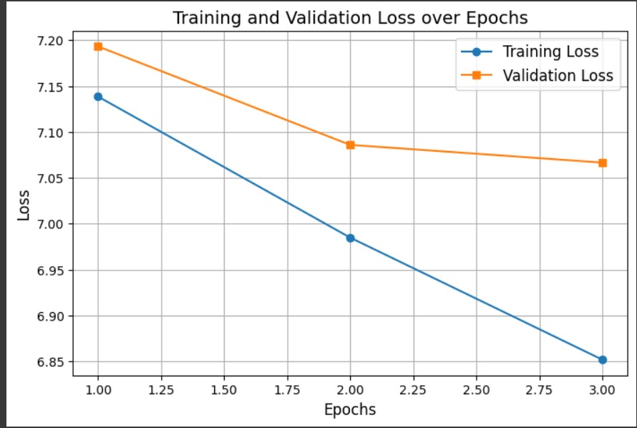
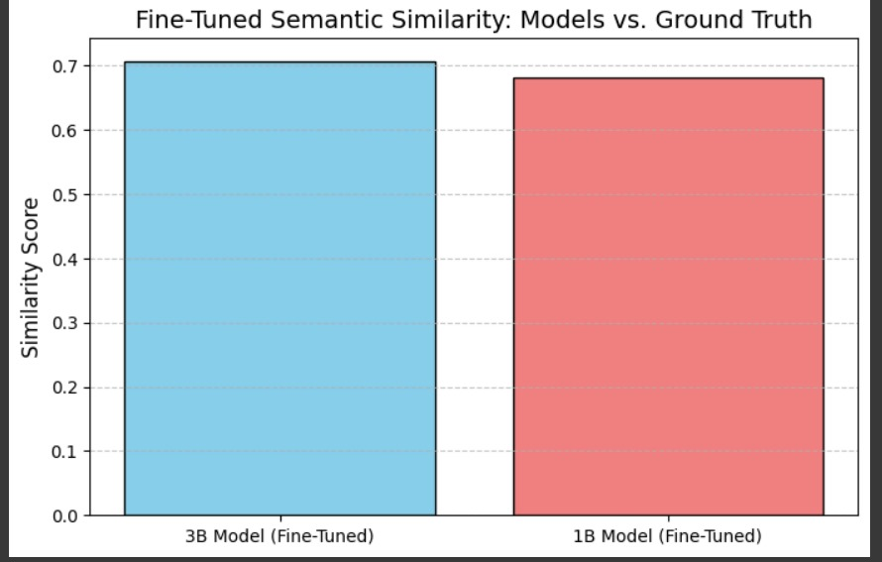
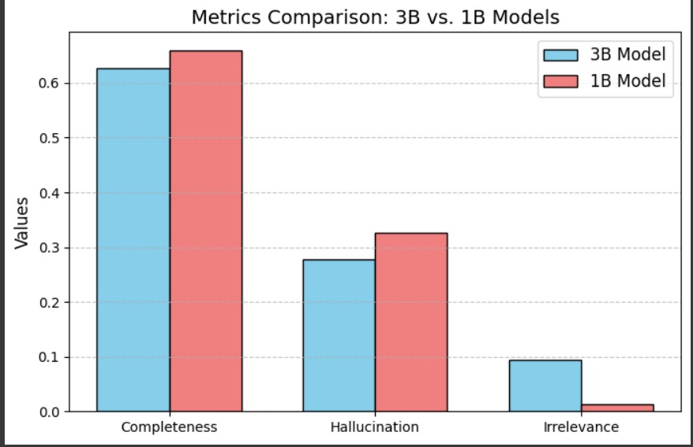
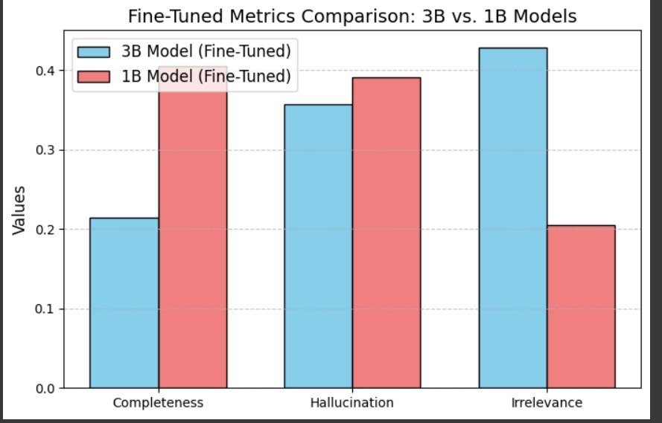

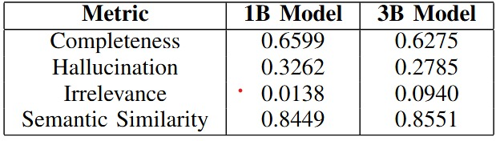

2025-AIS411-3
Long Document Summarization
Abstract:
This research investigates the potential of LLaMA models for summarizing long documents effectively. By employing fine-tuning techniques with the BookSum dataset and advanced evaluation metrics, the study addresses challenges such as hallucination and irrelevance. Results highlight the improved quality of summaries through a combination of fine-tuning and prompt engineering, contributing to advancements in document summarization technology.
AAIS411
Discussion and Conclusion:
The findings reveal that the fine-tuned 3B model outperformed the 1B model in completeness and semantic similarity while reducing hallucination. The 1B model demonstrated better irrelevance reduction, indicating suitability for precision-focused tasks. Overall, the study showcases the effectiveness of fine-tuning in improving summarization quality and suggests expanding datasets and refining architectures for future improvements.
Methodology:
The study utilized the LLama models (1B and 3B) for generating summaries, with fine-tuning performed on the Book Sum dataset to enhance accuracy. Evaluation was conducted using RAGEval metrics and semantic similarity analysis. Data preprocessing included tokenization, normalization, and embedding generation, ensuring optimal input preparation. The iterative training process ensured model reliability and performance.
AIS411
Achievements and Skills Gained:
Improved document summarization quality.
Learned fine-tuning and prompt engineering.
Mastered advanced evaluation metrics.
Gained data preprocessing and NLP skills.
Main results:
Group Members:

